Slide 1

SINGLE-ENDED 10T SRAM CELL WITH IMPROVED STABILITY
Presented by
SHRUTHI KRISHNAMITHRAN 312317106168
YAVANIKA.N 312317106306
Guided by MRS.G.ANITHA, B.E., M.E.,
ASSISTANT PROFESSOR
Department of Electronics & Communication Engineering,
St. Joseph’s College Of Engineering,
Chennai-119

Slide 2
CONTENT
Objective
Literature review
Existing system
Working operation of proposed system
Applications
Software Tools
References

Slide 3
OBJECTIVE
In 10T SRAM cell, the SRAM cell is built with 10 transistors using the same area used by 6T SRAM cell.
The area and the power consumption is reduced and the memory space is maximised.

Slide 4
LITERATURE REVIEW
S.No | TITLE OF THE PAPER | YEAR PUBLISHED | AUTHOR | CONTENT
1 | Single-ended 10T SRAM cell with improved stability | 2015 IEEE Transactions on very large scale integration (VLSI) systems | C.B. Kushwah et al. | In subthreshold regime, the data stability of 6T SRAM cell is a severe problem. A novel 10T SRAM cell with improved data stability is designed.

Slide 5
S.No | TITLE | AUTHOR | YEAR | CONTENT
2 | An 800-mhz mixed-vt4t igc embedded dram in 28-nm cmos bulk process for approximate storage application | R.Giterman, , N.Geuli, E.Mentovich, A.Burg, and A. Teman | 2019 | Gain-cell embedded DRAM (GC-eDRAM) is an attractive alternative to traditional static random access memory (SRAM) due to its high-density, low-leakage, and inherent two-ported operation, yet its dynamic nature leads to limited retention time and calls for periodic, power-hungry refresh cycles. The proposed memory can be used with conservative (i.e., 100% reliable) computing paradigms, but also in the context of approximate computing, featuring a small silicon footprint and random access bandwidth. Silicon measurements demonstrate successful operation at 800 MHz under a 900-mv supply while retaining between 30% and 45% lower bitcell area than a single-ported six-transistor (6T) SRAM and a two-ported six-transistor (8T) SRAM in the same technology

Slide 6
S.No | TITLE | AUTHOR | YEAR | CONTENT
3 | A 32-nm subthreshold 7T SRAM bit cell with read assist | S.Gupta, K.Gupta, and N.Pandey | 2017. | The implementation of the six-transistor (6T) static random access memory cell in deep submicrometer region has become difficult due to the compromise between area, power, and performance, with local and global variations only exacerbating the problem further. To impede the read–write conflict of the 6T cell, the seven-transistor (7T) cell with a noise-margin-free read operation has previously been proposed.. The novel topology also helps reduce power consumption by achieving a lower data retention voltage point. A read assist has been proposed to greatly enhance the performance of the single-ended read operation in ST region. Large improvements in various performance metrics of the proposed cell have been attained while simultaneously achieving a low area of $0.254~\mu \text{m}^{2}$ per bit cell on the 32-nm technology node

Slide 7
SRAM Features
SRAM is a type of semiconductor random-access memory (RAM) that uses bistable latching circuitry (flip-flop) to store each bit.
data is eventually lost when the memory is not powered.
The term static differentiates SRAM from DRAM which must be periodically refreshed.

Slide 8
SRAM’S modes of operation
1) Data retention or standby mode of operation - an SRAM cell is able to retain the data as long as it is powered.
2) Read operation – To read the data from the cell.
3) Write operation – To write the data into the cell.

Slide 9
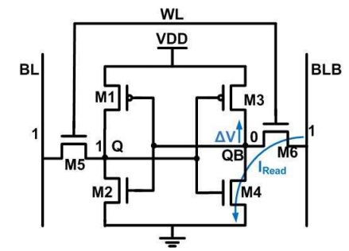
EXISTING SYSTEM
Conventional 6T SRAM Cell

Slide 10
Cross coupled inverter pairs.
Access transistors to control read/write operations.
WL=1, enables read/write operations.
WL=0, memory in hold state.

Slide 11
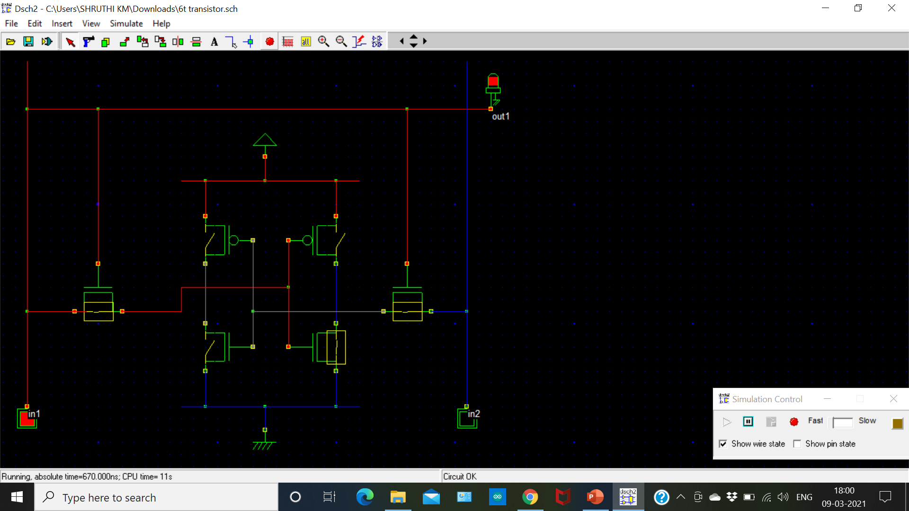

Slide 12
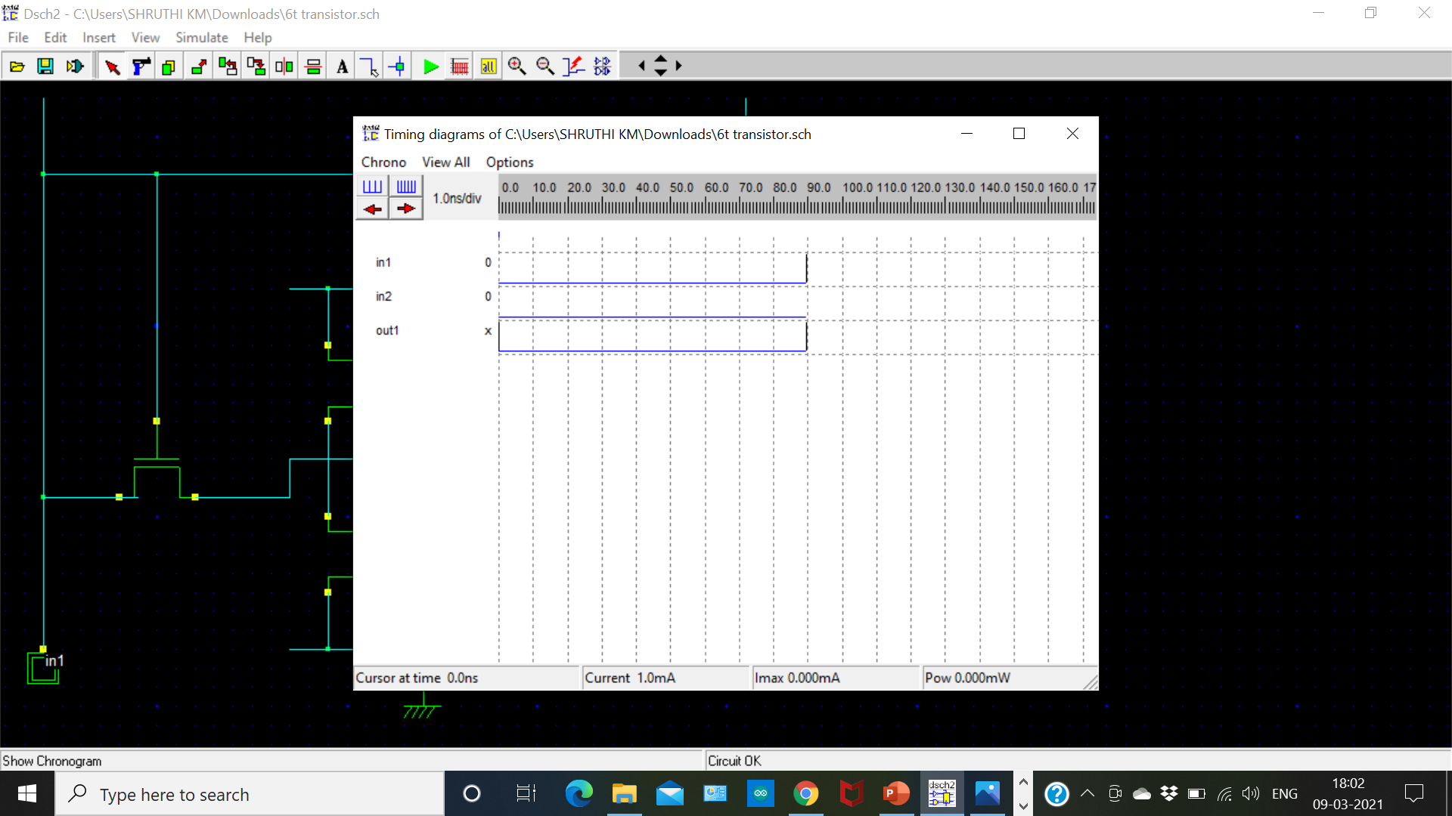

Slide 13
EXISTING SYSTEM TRUTH TABLE
IN1 | IN2 | OUT
0 | 0 | 0
0 | 1 | 0
1 | 0 | 1
1 | 1 | 1

Slide 14
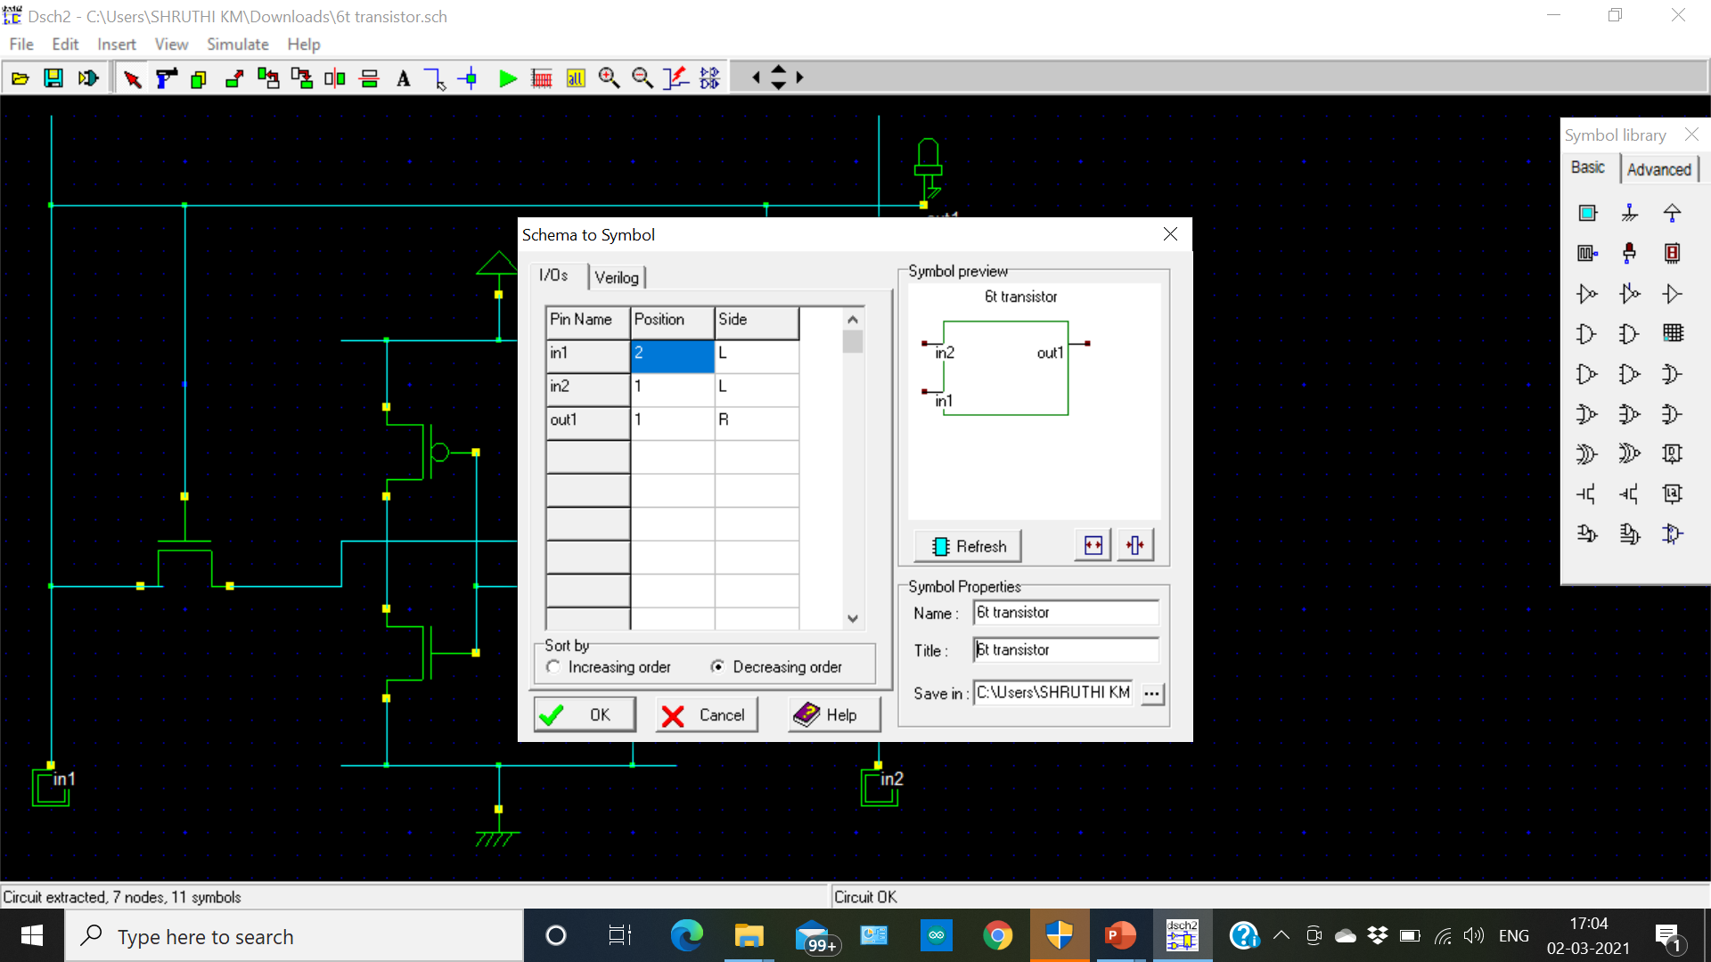

Slide 15
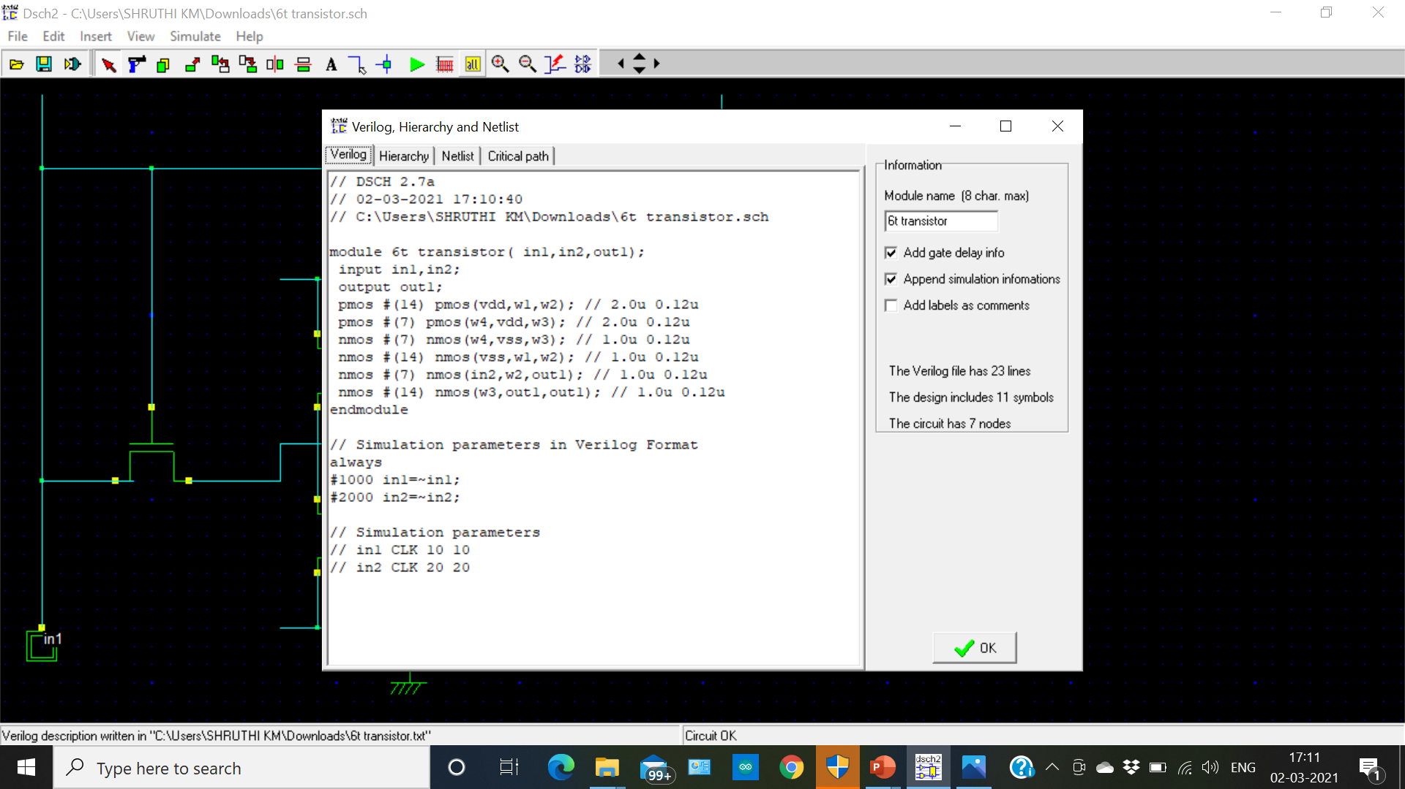

Slide 16
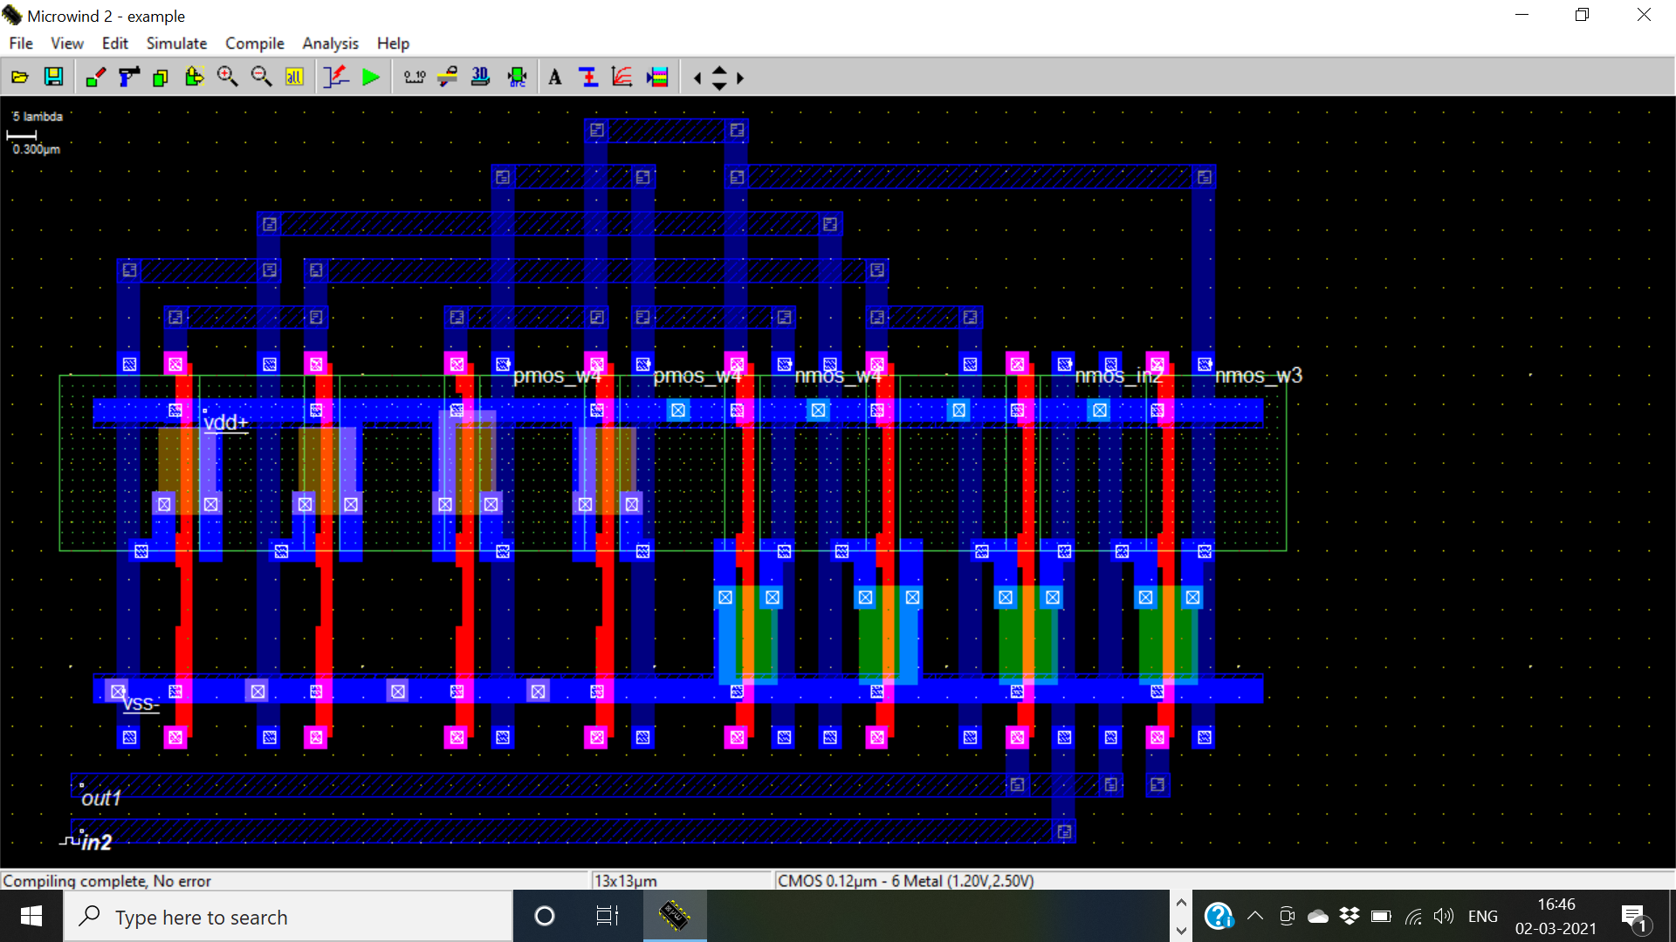

Slide 17
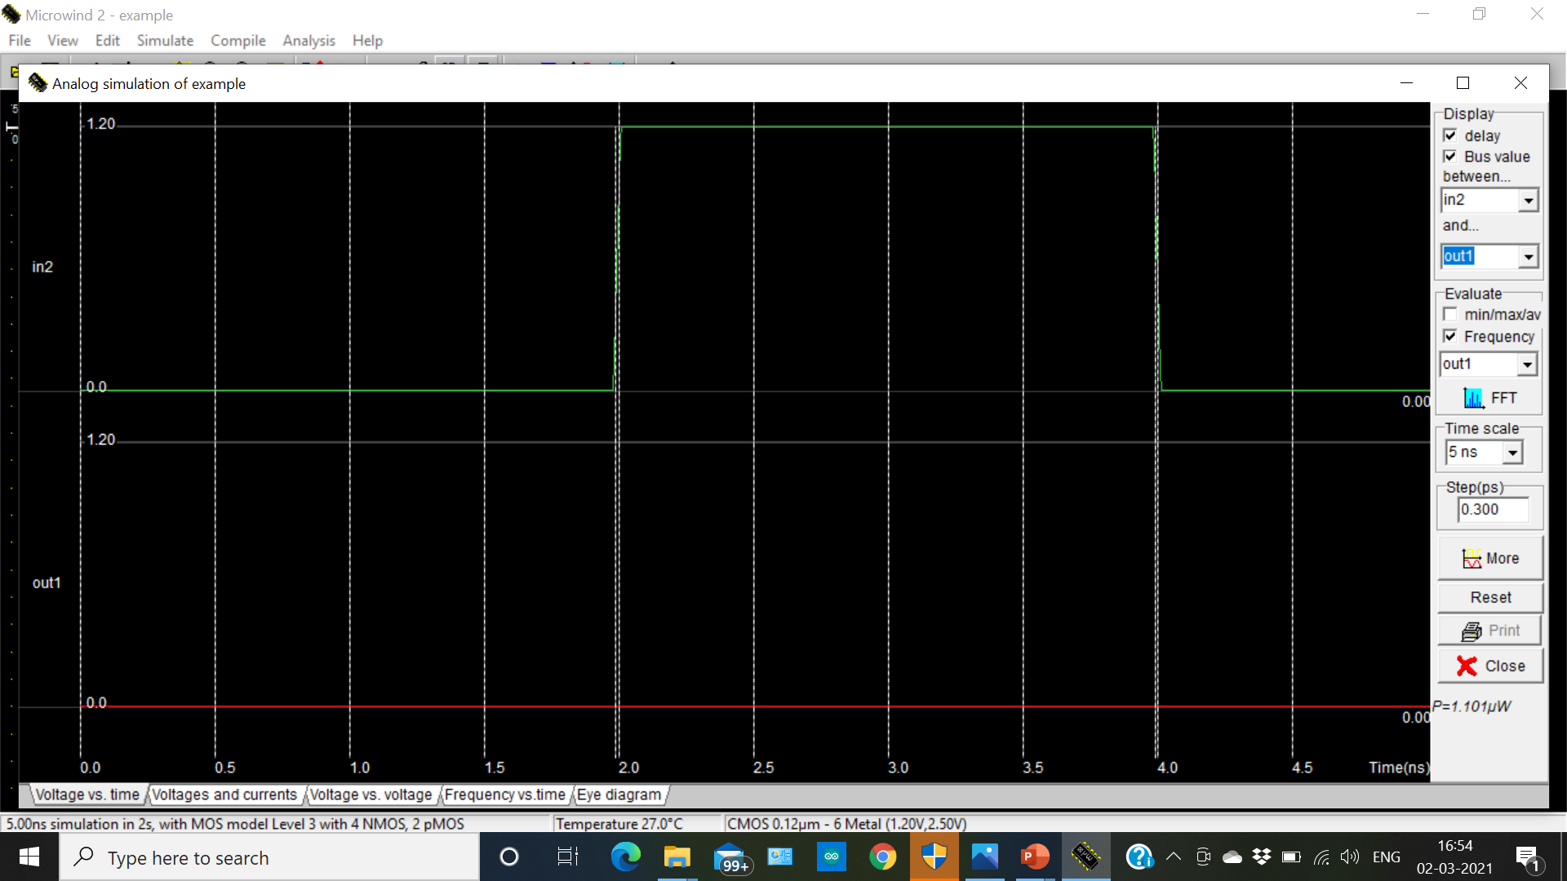

Slide 18
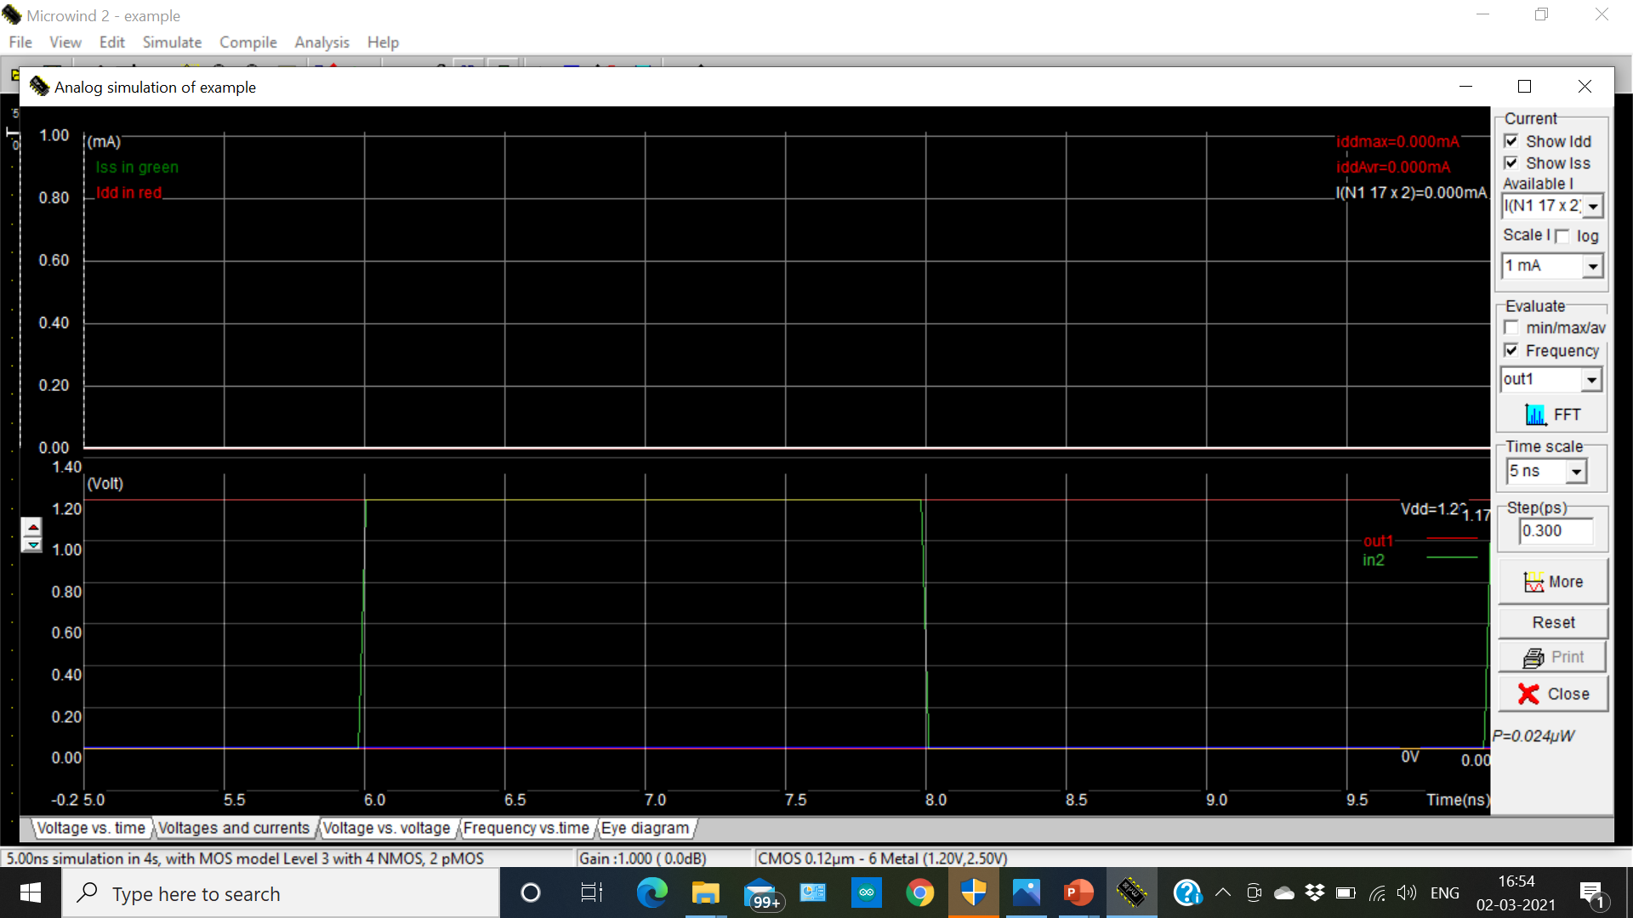

Slide 19
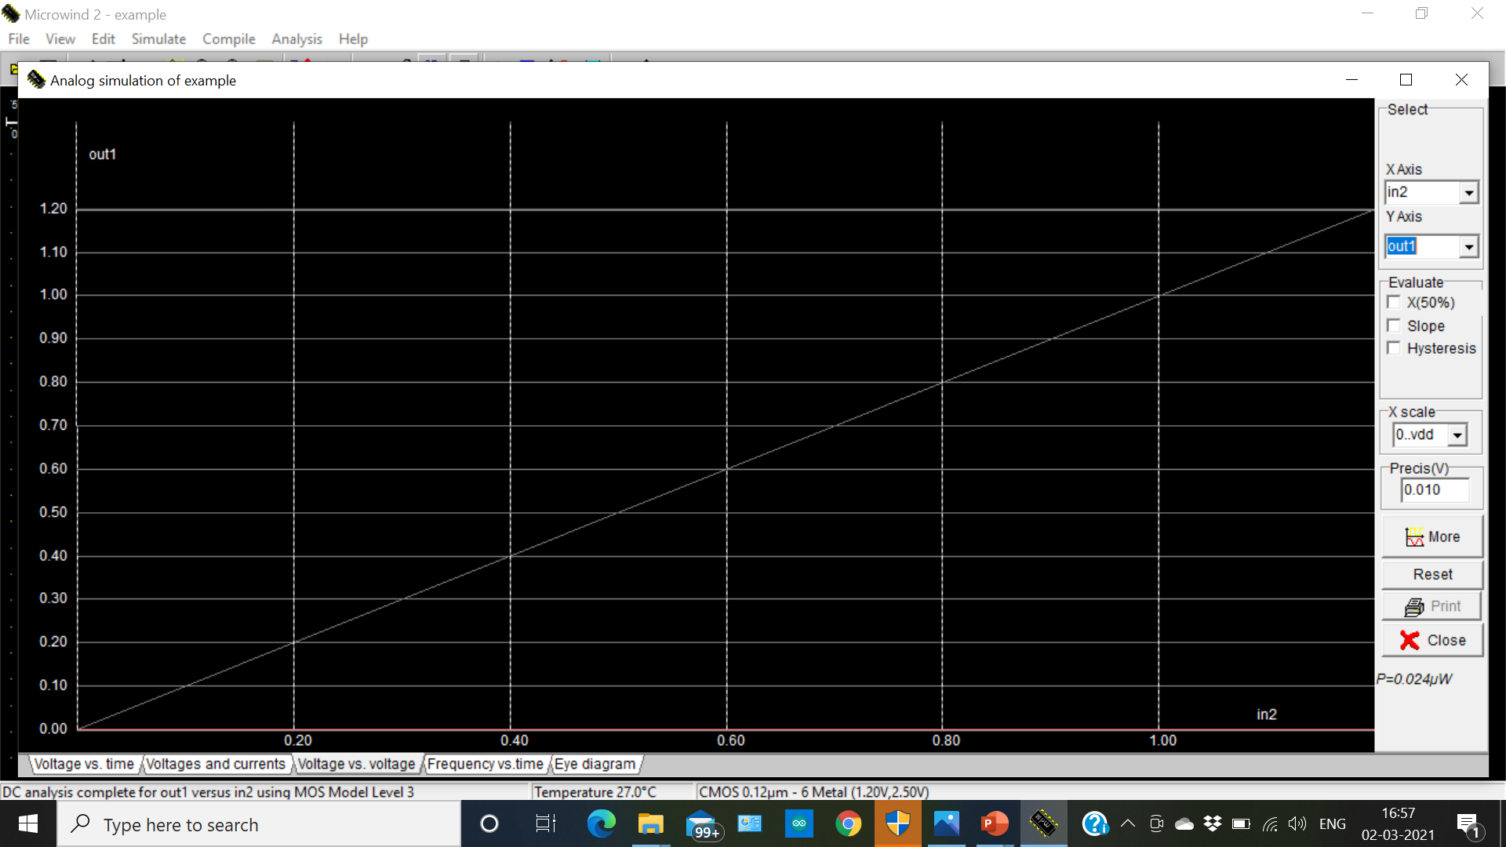

Slide 20
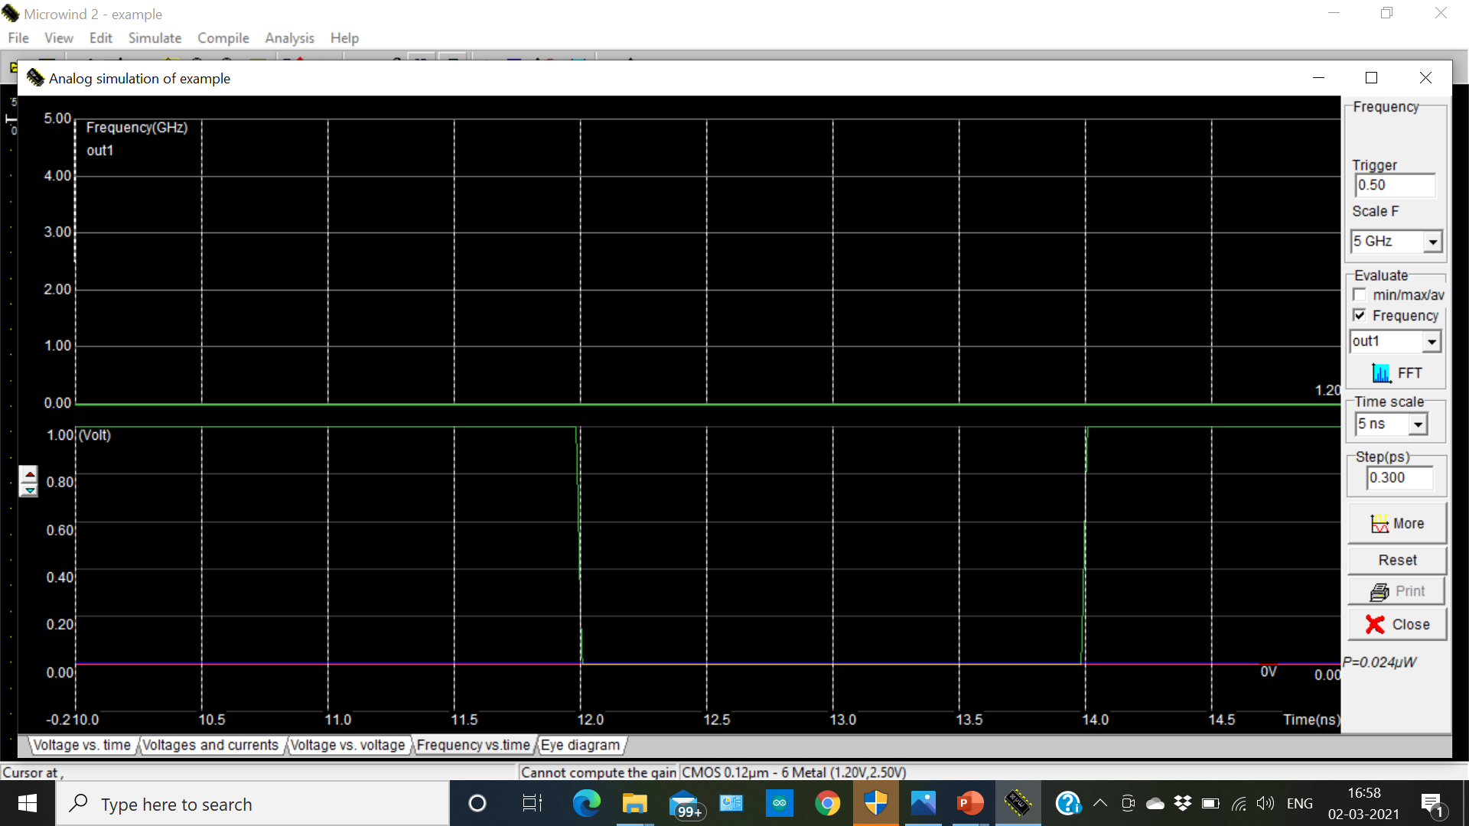

Slide 21
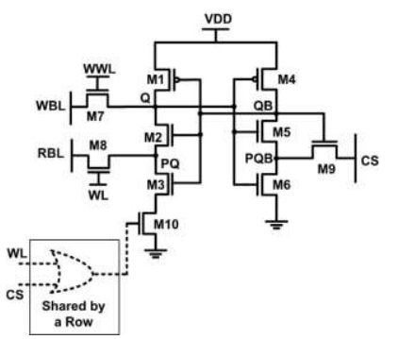
WORKING OPERATION OF PROPOSED SYSTEM 6T SRAM CELL

Slide 22
WBL to write the data into the cell.
RBL to read the cell content.
During write 0: WBL & RBL=0, WWL & WL=1,CS=0.
During write 1: WBL=1 , WWL =1, WL &CS =0.
During read: RBL=1, WL & CS=1.
During hold: WWL & WL=0, CS=1.

Slide 23
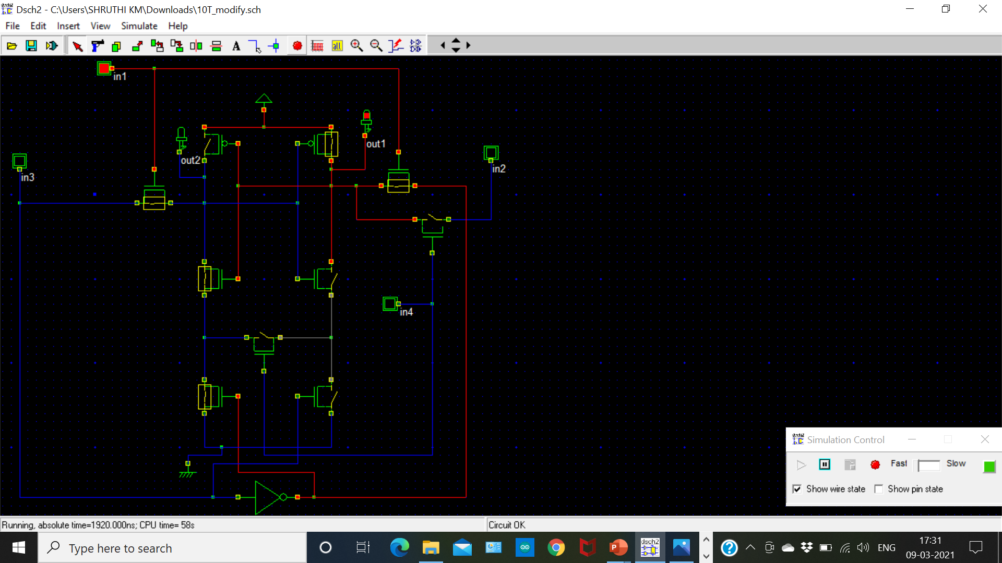

Slide 24
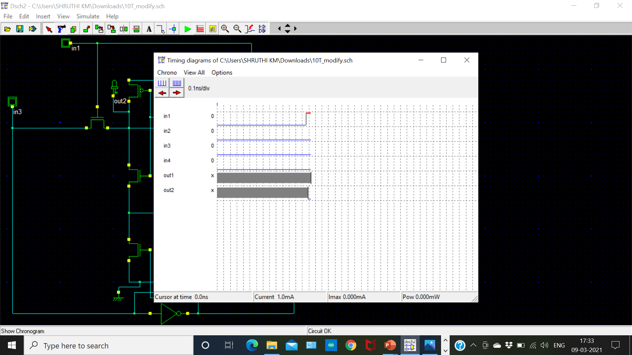

Slide 25
IN1 | IN2 | IN3 | IN4 | OUT1 | OUT2
0 | 0 | 0 | 0 | 0 | 0
0 | 0 | 0 | 1 | 0 | 1
0 | 0 | 1 | 0 | 0 | 0
0 | 0 | 1 | 1 | 0 | 1
0 | 1 | 0 | 0 | 0 | 0
0 | 1 | 0 | 1 | 1 | 0
0 | 1 | 1 | 0 | 0 | 0
0 | 1 | 1 | 1 | 1 | 0
1 | 0 | 0 | 0 | 1 | 0
1 | 0 | 0 | 1 | 0 | 0
1 | 0 | 1 | 0 | 0 | 1
1 | 0 | 1 | 1 | 0 | 1
1 | 1 | 0 | 0 | 1 | 0
1 | 1 | 0 | 1 | 1 | 0
1 | 1 | 1 | 0 | 0 | 1
1 | 1 | 1 | 1 | 1 | 1

Slide 26
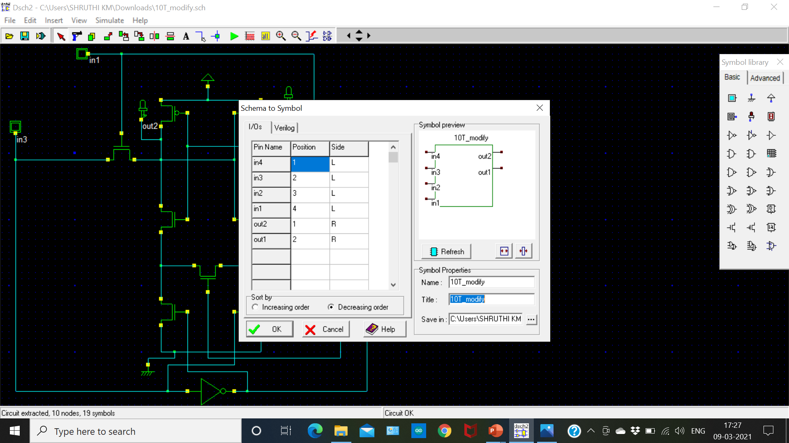

Slide 27
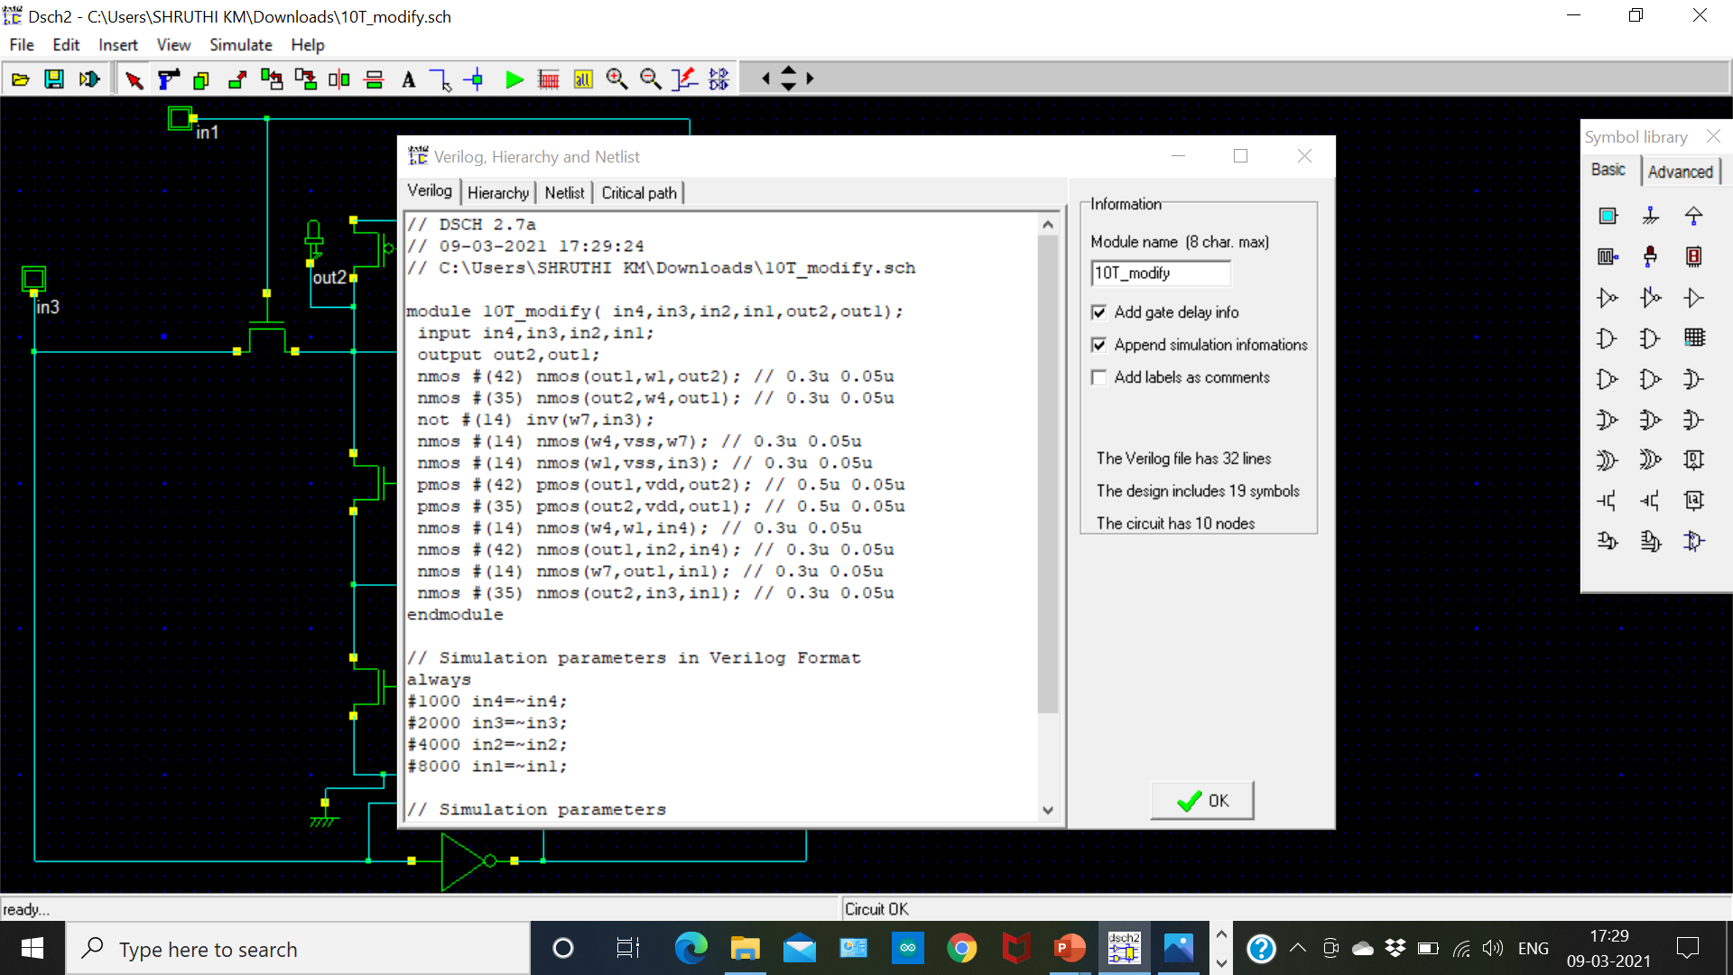

Slide 28
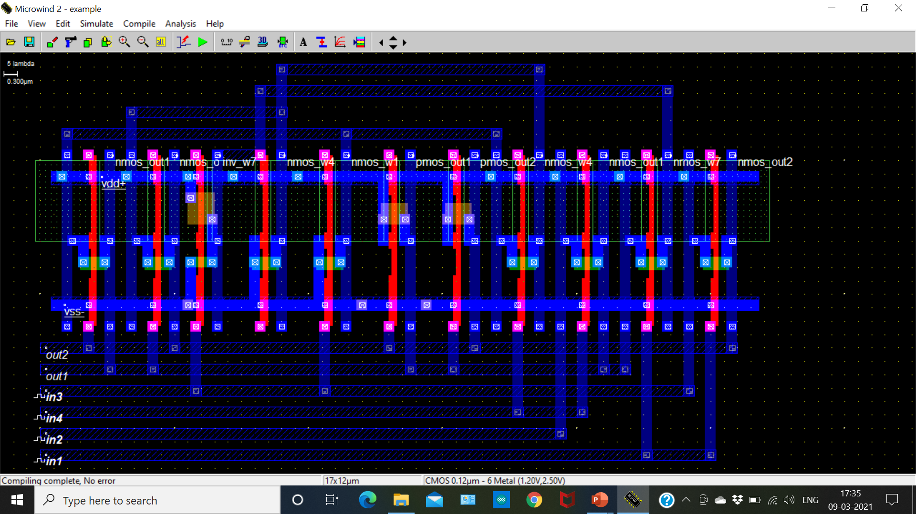

Slide 29
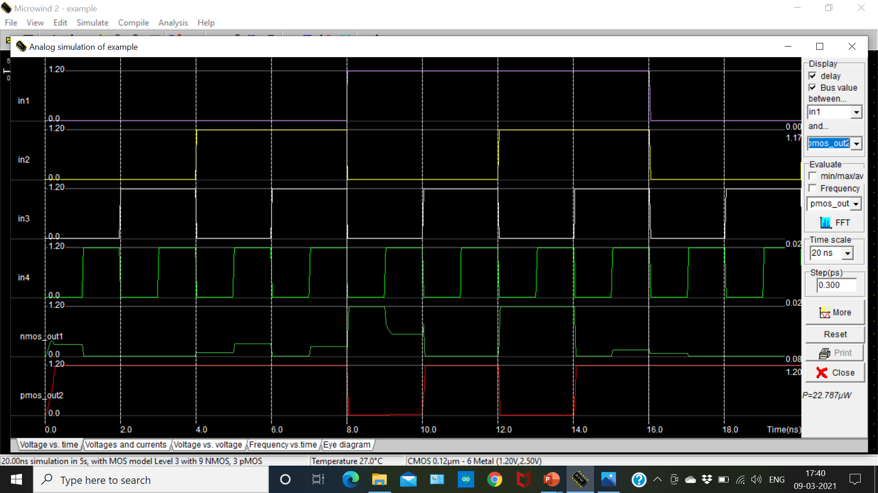

Slide 30
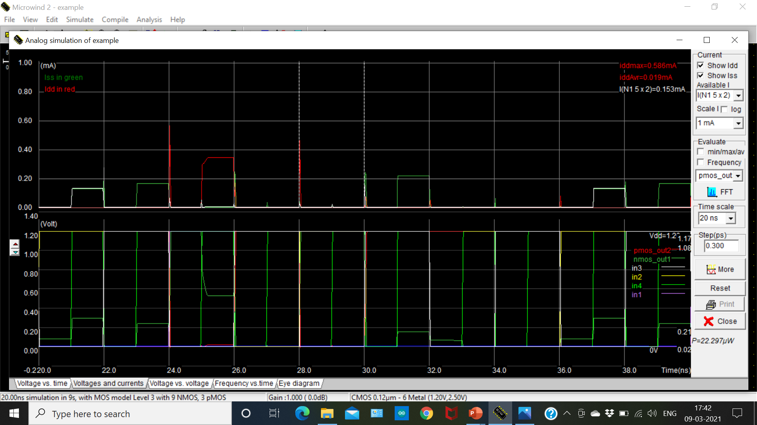

Slide 31
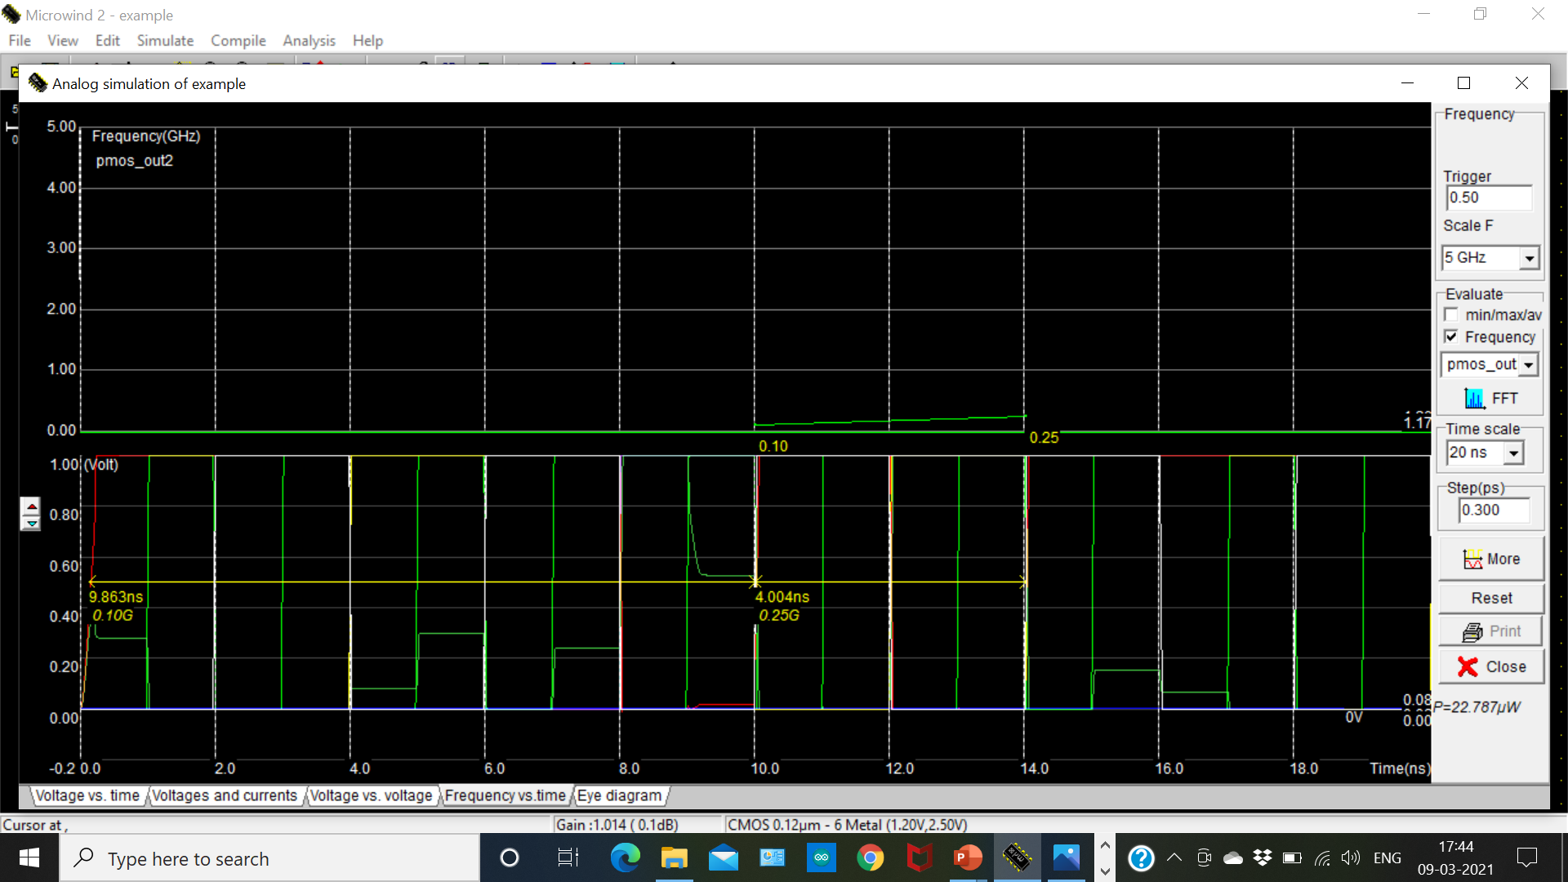

Slide 32
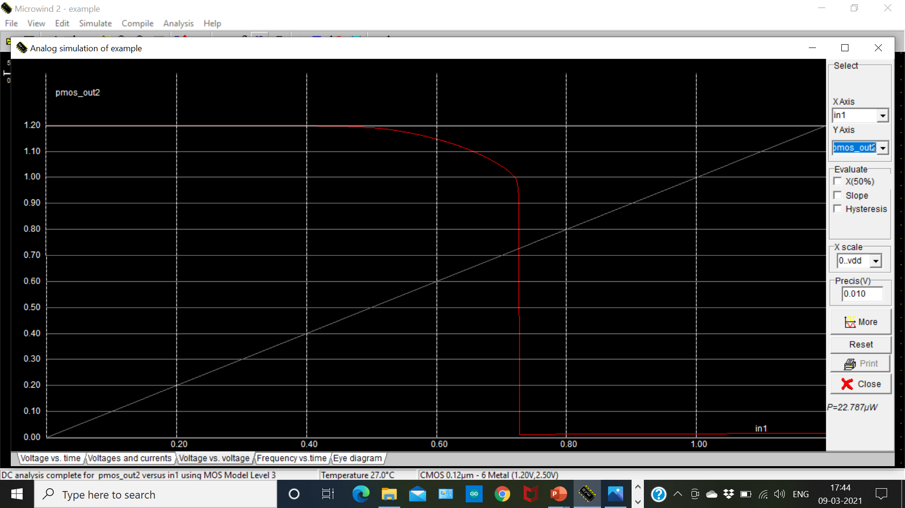

Slide 33
AREA EFFICIENCY
MOS SIZE (µm) | 6T SRAM Cell | 10T SRAM Cell
Width of PMOS transistor | 0.720µm | 0.720µm
Length of PMOS transistor | 0.120µm | 0.120µm
Width of NMOS transistor | 0.240µm | 0.240µm
Length of NMOS transistor | 0.120µm | 0.120µm

Slide 34
APPLICATIONS
Digital cameras, cell phones, etc.
Internal CPU caches, hard disk buffers.
LCD screens and printers employ static RAM to hold the image displayed.
Personal computers, work stations.

Slide 35
SOFTWARE TOOLS
Digital Schematic (DSCH) Tool -Converts the digital circuits into Verilog file.
Micro wind Tool- Compile the digital circuits using Verilog file.

Slide 36
REFERENCES
Pal S, Islam A (2016), “Variant Tolerant Differential 8T SRAM Cell for Ultralow Power Applications”, IEEE Trans Comput Aided Des Integr Circuits Syst., Volume 35, Issue 4, pp. 549–558.
Sridhara SR et al. (2011), “Microwatt Embedded Processor Plateform for Medical System-on-Chip Applications”, IEEE J Solid State Circuits, Volume 46, Issue 4, pp. 721– 730. 3.
Lin S, Kim Y, Lombardi F (2008), “A Highly-Stable Nanometer Memory for Low-Power Design”, IEEE International Workshop on Design and Test of Nano Devices, Circuits and Systems.
Calhoun B, Chandrakasan A (2006), “Static Noise Margin Variation for Sub-Threshold SRAM in 65-nm CMOS”, IEEE J Solid State Circuits, Volume 41, Issue 7, pp. 1673–1679.
Sung-Mo Kang, Yusuf Leblebici (2003), “CMOS Digital Integrated Circuits Analysis and Design”, 3rd Edn. TMH; New Delhi.

